Slide 1
Balance assessment a Three Dimensional picture
Mohammad Shafique AsghAR

Slide 2
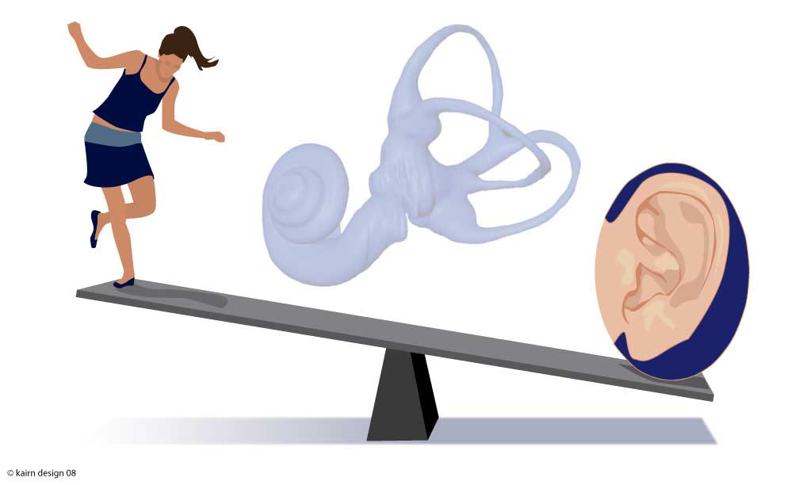

Slide 3
Three pillars
Sensory Part
Motor part
Functional part

Slide 4
Sensory Part
Vision
Somatosensory
Vestibular system

Slide 5
Central part/integration
Vestibular neucleus
Brainstem, Cerebellum
Higher centres

Slide 6
Motor Part
VOR (vestibulo occular reflex)
VCR (Vestibulocolic Reflex)
VSR (Vestibulospinal reflex)

Slide 7
Central Integration
Vestibular
Vision
Somatosensory

Slide 8
Functional Aspect
Effective utilization of the available senses and adopt a strategy to be upright.
Motor control test (MOT): Looks at sequential spinal and long loop responses and coordination of ankle thigh and lower trunk muscles.
Sensory organization test (SOT): Looks at patients performance in progressively more difficult situations.

Slide 9
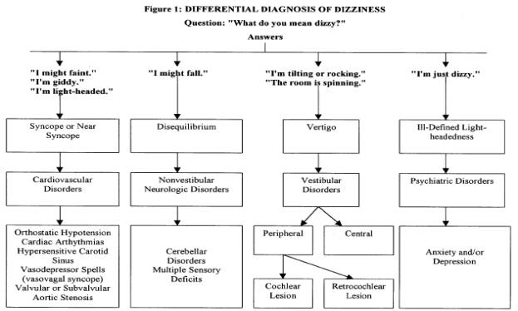

Slide 10
ENG abnormalities and suspected site of lesion
Test | Type of abnormality | Suspected site of lesion.
Saccade | Ipsilateral dysmetria Bilateral dysmetria Decreased velocity Internuclear opthalmoplegia | Cerebellopontine angle Cerebellum Throughout the CNS, Muscle weakness or peripheral nerve palsy. Medial longitudinal fasciculus
Pursuit | Breakup Saccade | Brainstem or cerebellum Cerebellum

Slide 11
ENG abnormalities and suspected site of lesion
Test | Type of abnormality | Suspected site of lesion
Gaze | Direction fixed and horizontal Direction changing and vertical Upbeating Downbeating Rotary | Peripheral vestibular Brainstem Brainstem or cerebellum Cervico medullary junction or cerebellum Vestibular nuclei/brainstem
FFS | Less than 40% decrease | Brainstem or cerebellum

Slide 12
ENG abnormalities and suspected site of lesion
Test | Type of Abnormality | Suspected site of lesion
Positional | Direction fixed Direction changing | Nonlocalizing or peripheral Nonlocalizing or central
Dix Hallpike | Classic | Peripheral vestibular –undermost ear
Caloric | Unilateral or bilateral weakness Directional | Peripheral vestibular Nonlocalizing Preponderance

Slide 13
Flow chart
Baseline thresholds
Shape of audiogram
PTA
PTA
ABR
Ecoch.G
VEMP
Retrocochlear pathology/
VEMP may add credibility
Dizzy battery
PTA
ABR
Ecoch.G
ENG
Rotary
Chair
VAT
oVEMP
cVEMP
vHIT
Cochlear N
ABR
MD/EH
Drop attacks
Ecoch.G
VIII N
VAT/Positioning/vHIT
Ant.SCC
VAT/vHIT
ENG
oVEMP
Sup. Vest. N
Caloric/
Posiit/Rot Chair/vHIT
Lat.SCC
Utricle
oVEMP
VAT
ENG
VEMP
Post.SCC
VAT/Positioning/vHIT
cVEMP
Saccule
Vestibular N
Inf. Vest. N

Slide 14
VEMP: literature Review (1994-2006)*
Vestibular Disorder . | Total number | Abnormal number | Normal number
Meniere’s disease (Endolymphatic hydrops) | 320 | 158 | 162
Vestibular schwannoma | 306 | 238 | 68
SSCD | 64 | 64 | 0
Tullio phenomenon | 13 | 12 | 1
Vestibular neuritis/ Labyrinthitis | 99 | 49 | 50
Sensorineural HL | 46 | 4 | 42
Multiple sclerosis | 167 | 101 | 66

Slide 15
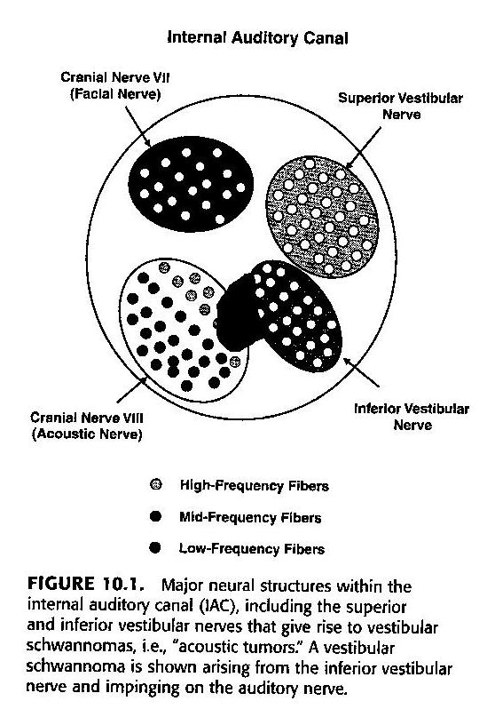

Slide 16
ENG abnormalities and suspected site of lesion
Test | Type of abnormality | Suspected site of lesion.
Saccade | Ipsilateral dysmetria Bilateral dysmetria Decreased velocity Internuclear opthalmoplegia | Cerebellopontine angle Cerebellum Throughout the CNS, Muscle weakness or peripheral nerve palsy. Medial longitudinal fasciculus
Pursuit | Breakup Saccade | Brainstem or cerebellum Cerebellum

Slide 17
ENG abnormalities and suspected site of lesion
Test | Type of abnormality | Suspected site of lesion
Gaze | Direction fixed and horizontal Direction changing and vertical Upbeating Downbeating Rotary | Peripheral vestibular Brainstem Brainstem or cerebellum Cervico medullary junction or cerebellum Vestibular nuclei/brainstem
FFS | Less than 40% decrease | Brainstem or cerebellum

Slide 18
ENG abnormalities and suspected site of lesion
Test | Type of Abnormality | Suspected site of lesion
Positional | Direction fixed Direction changing | Nonlocalizing or peripheral Nonlocalizing or central
Dix Hallpike | Classic | Peripheral vestibular –undermost ear
Caloric | Unilateral or bilateral weakness Directional Preponderance | Peripheral vestibular Nonlocalizing

Slide 19
SPINNED
PERIPHERAL
CENTRAL
Sudden (Onset) | Yes | Slow, gradual
Positional | Yes | No
Intensity | Severe | Ill defined
Nausea/Diaphoresis | Frequent | Infrequent
Nystagmus | Torsional/horizontal | Vertical
Ear (hearing loss) | Can be present | Absent
Duration | Paroxysmal | Constant
CNS signs | Absent | Usually present
Carvalho et al. CTU , Oct, 2004

